Slide 1
CSC373
Week 3

Slide 2
Huffman Code
Variable
Length encoding
Better approach because every letter has a different frequency of occurrence

Slide 3
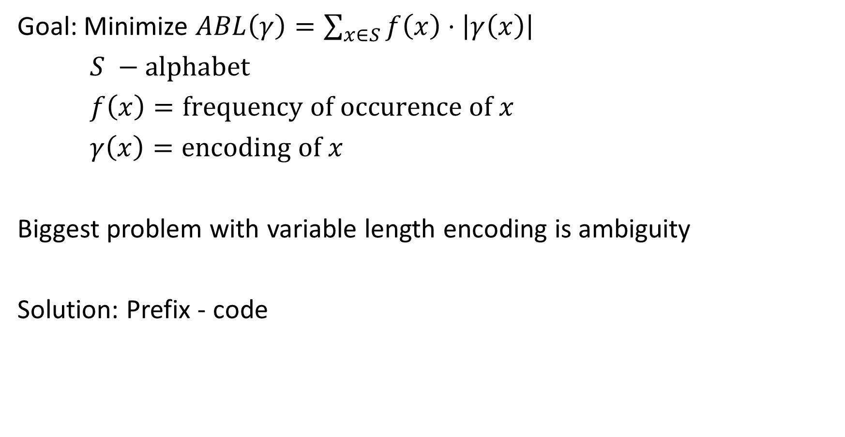
Goal: Minimize $ABL\left(γ\right)=\sum_{x∈S}{f\left(x\right)⋅\left|γ\left(x\right)\right|}$
$S −\text{alphabet}$
$f\left(x\right)=\text{frequency} \text{of} \text{occurence} \text{of} x$
$γ\left(x\right)=\text{encoding} \text{of} x$
Biggest problem with variable length encoding is ambiguity
Solution: Prefix - code

Slide 4




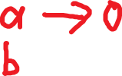
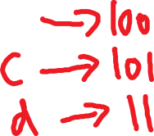




How to generate prefix codes?
Prefix-Code $↔$ Full binary tree

Slide 5








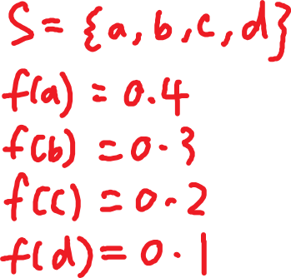


Notes

Slide 6

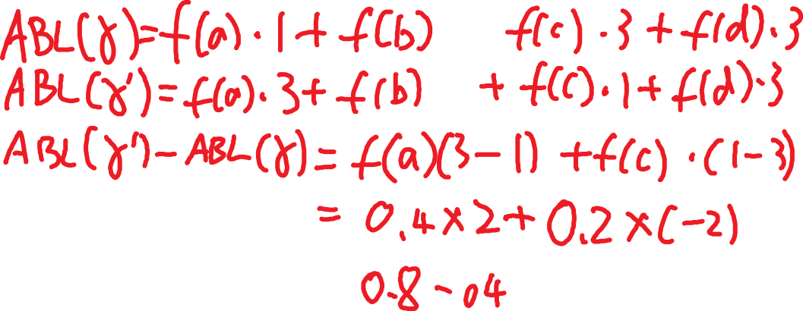


Notes

Slide 7





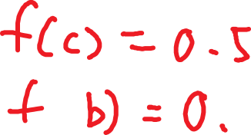


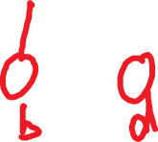
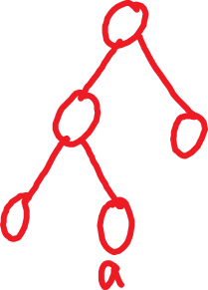


Slide 8

Claim: Let $x$ and $y$ be the two least frequent letters. Then there is same optimal tree where $x$ and $y$ are siblings.

Slide 9
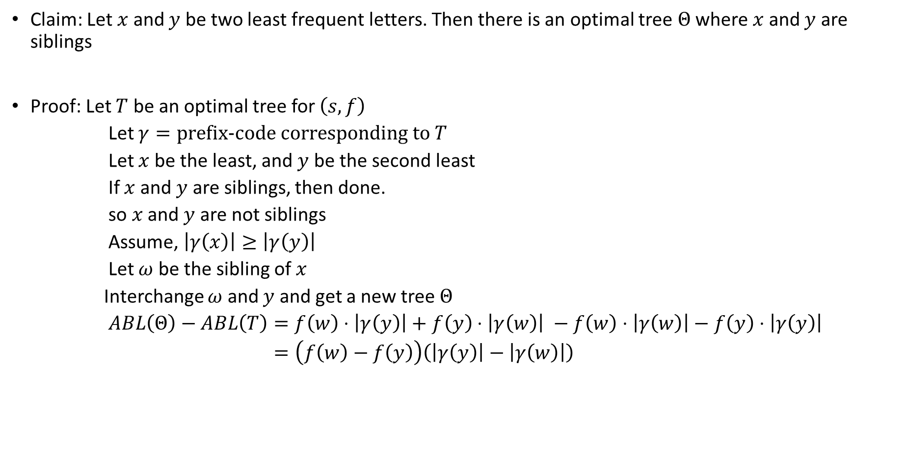
Claim: Let $x$ and $y$ be two least frequent letters. Then there is an optimal tree $Θ$ where $x$ and $y$ are siblings
Proof: Let $T$ be an optimal tree for $\left(s, f\right)$
Let $γ=\text{prefix}\text{−}\text{code} \text{corresponding} \text{to} T$
Let $x$ be the least, and $y$ be the second least
If $x$ and $y$ are siblings, then done.
so $x$ and $y$ are not siblings
Assume, $\left|γ\left(x\right)\right|≥\left|γ\left(y\right)\right|$
Let $ω$ be the sibling of $x$
Interchange $ω$ and $y$ and get a new tree $Θ$
$ABL\left(Θ\right)−ABL\left(T\right)=f\left(w\right)⋅\left|γ\left(y\right)\right|+$ $f\left(y\right)⋅\left|γ\left(w\right)\right| −f\left(w\right)⋅\left|γ\left(w\right)\right|−f\left(y\right)⋅\left|γ\left(y\right)\right|$
$=\left(f\left(w\right)−f\left(y\right)\right)\left(\left|γ\left(y\right)\right|−\left|γ\left(w\right)\right|\right)$

Slide 10

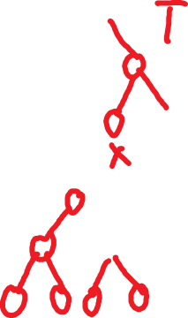




Notes

Slide 11

Proof (continued)
So, $\left|γ\left(y\right)\right|−\left|γ\left(w\right)\right|=\left|γ\left(y\right)\right|−\left|γ\left(x\right)\right|≤0$
So, $ABL\left(Θ\right)−ABL\left(T\right)≤0$
Since $T$ is optimal, $ABL\left(Θ\right)−ABL\left(T\right)≮0$
$⇒ABL\left(Θ\right)−ABL\left(T\right)=0$
$⇒ABL\left(Θ\right)=ABL\left(T\right)$
$⇒Θ \text{is} \text{optimal}$

Slide 12
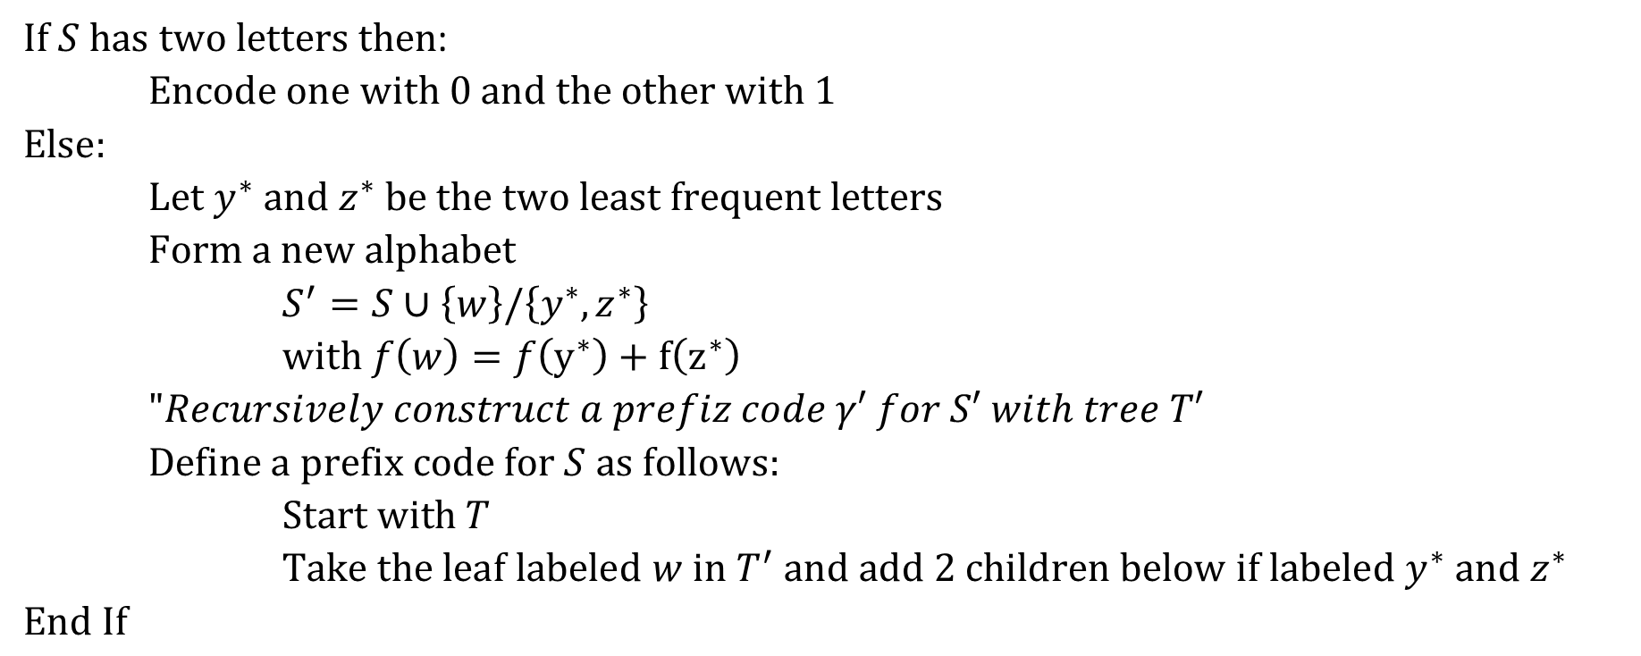
Huffman Coding
$\text{If} S \text{has} \text{two} \text{letters} \text{then}$:
$\text{Encode} \text{one} \text{with}\text{ 0 }\text{and} \text{the} \text{other} \text{with}\text{ 1}$
$\text{Else}:$
$\text{Let} y^{∗} \text{and} z^{∗} \text{be} \text{the} \text{two} \text{least} \text{frequent} \text{letters}$
$\text{Form} \text{a} \text{new} \text{alphabet}$
$S^{′}=S∪\left\{w\right\}/\left\{y^{∗}, z^{∗}\right\}$
$\text{with} f\left(w\right)=f\left(y^{∗}\right)+f\left(z^{∗}\right)$
$"Recursively construct a prefiz code γ′ for S′ with tree T′$
$\text{Define} \text{a} \text{prefix} \text{code} \text{for} S \text{as} \text{follows}:$
$\text{Start} \text{with} T$
$\text{Take} \text{the} \text{leaf} \text{labeled} w \text{in} T^{′} \text{and} \text{add}\text{ 2 }\text{children} \text{below} \text{if} \text{labeled}$ $y^{∗} \text{and} z^{∗}$
$\text{End} \text{If}$

Slide 13
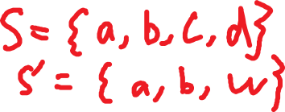
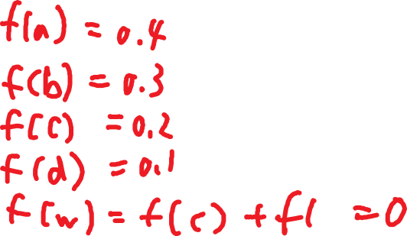
Notes

Slide 14
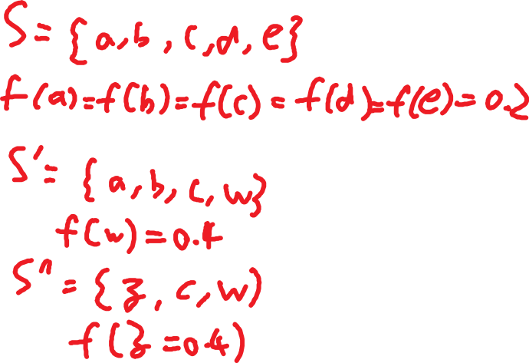
Notes

Slide 15
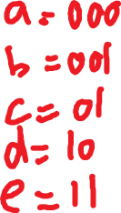
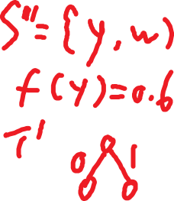
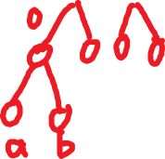
Notes

Slide 16
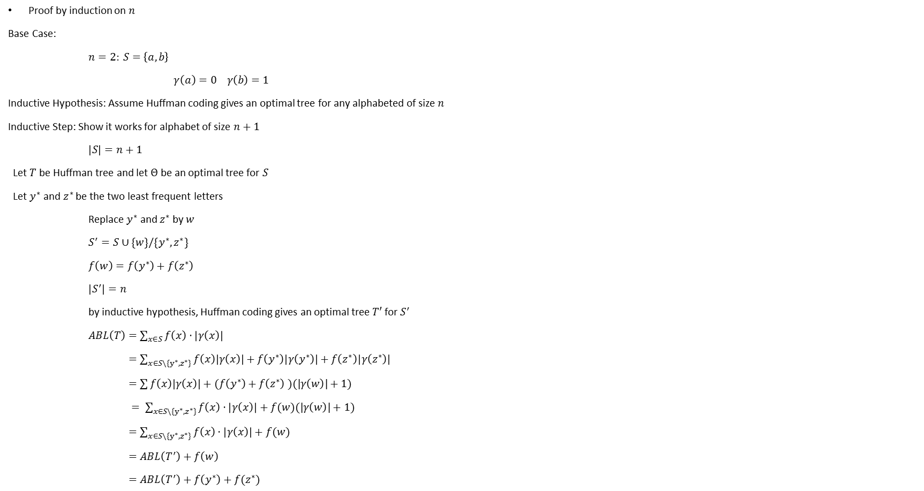
Proof why Huffman Coding works
Proof by induction on $n$
Base Case:
$n=2:$ $S=\left\{a, b\right\}$
$γ\left(a\right)=0 γ\left(b\right)=1$
Inductive Hypothesis: Assume Huffman coding gives an optimal tree for any alphabeted of size $n$
Inductive Step: Show it works for alphabet of size $n+1$
$\left|S\right|=n+1$
Let $T$ be Huffman tree and let $Θ$ be an optimal tree for $S$
Let $y^{∗}$ and $z^{∗}$ be the two least frequent letters
Replace $y^{∗}$ and $z^{∗}$ by $w$
$S^{′}=S∪\{w\}/\{y^{∗}, z^{∗}\}$
$f\left(w\right)=f\left(y^{∗}\right)+f\left(z^{∗}\right)$
$\left|S^{′}\right|=n$
by inductive hypothesis, Huffman coding gives an optimal tree $T′$ for $S^{′}$
$ABL\left(T\right)=\sum_{x∈S}{f\left(x\right)⋅\left|γ\left(x\right)\right|}$
$=\sum_{x∈S\backslash \{y^{∗},z^{∗}\}}{f\left(x\right)\left|γ\left(x\right)\right|}+f\left(y^{∗}\right)\left|γ\left(y^{∗}\right)\right|+f\left(z^{∗}\right)\left|γ\left(z^{∗}\right)\right|$
$=\sum{f\left(x\right)\left|γ\left(x\right)\right|+(f\left(y^{∗}\right)+f\left(z^{∗}\right)}$ $)(|γ\left(w\right)|+1)$
$= \sum_{x∈S\backslash \{y^{∗},z^{∗}\}}{f\left(x\right)⋅\left|γ\left(x\right)\right|+f(w)(|γ\left(w\right)|+1)}$
$=\sum_{x∈S\backslash \{y^{∗},z^{∗}\}}{f\left(x\right)⋅\left|γ\left(x\right)\right|+f(w)}$
$=ABL\left(T^{′}\right)+f\left(w\right)$
$=ABL\left(T^{′}\right)+f\left(y^{∗}\right)+f(z^{∗})$

Slide 17


Proof (continued)
Assume for a contradiction that $T$ is not optimal
Let $Ο$ be an optimal tree for $S$ such that $y^{∗}$ and $z^{∗}$ are sibling in $Ο$ (by claim proved before)
If you remove $y^{∗}$ and $z^{∗}$ from $Ο$ and replace them by $w$ with $f\left(w\right)=f\left(y^{∗}\right)+f(z^{∗})$
Then this new tree $Ο′$ must be optimal for $S^{′}$
So $ABL\left(Ο^{′}\right)=ABL\left(T^{′}\right)$
$⇒ABL\left(Ο^{′}\right)+f\left(y^{∗}\right)+f\left(z^{∗}\right)=ABL\left(T^{′}\right)+f\left(y^{∗}\right)+f\left(z^{∗}\right)=ABL\left(T\right)$

Slide 18

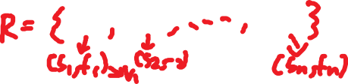



Weighted Interval Scheduling
Single Resource
Input
Goal: Maximize the total value of jobs scheduled

Slide 19
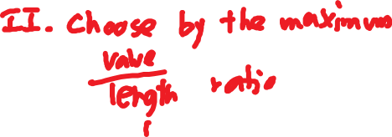

Use Greedy

Slide 20



Use Greedy (continued)

Slide 21
III. Dynamic Programming
Decompose a problem into several subproblems and combine solutions

Slide 22
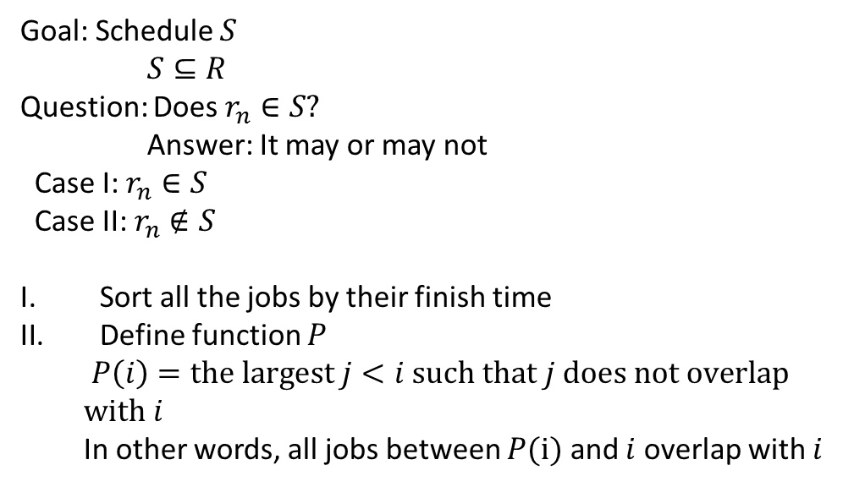
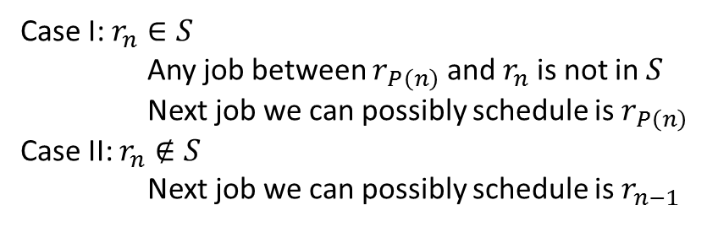
Goal: Schedule $S$
$S⊆R$
Question: Does $r_{n}∈S?$
Answer: It may or may not
Case I: $r_{n}∈S$
Case II: $r_{n}∉S$
Sort all the jobs by their finish time
Define function $P$
$P\left(i\right)=\text{the} \text{largest} j<i \text{such} \text{that} j \text{does} \text{not} \text{overlap} \text{with} i$
In other words, all jobs between $P(i)$ and $i$ overlap with $i$
Case I: $r_{n}∈S$
Any job between $r_{P\left(n\right)}$ and $r_{n}$ is not in $S$
Next job we can possibly schedule is $r_{P\left(n\right)}$
Case II: $r_{n}∉S$
Next job we can possibly schedule is $r_{n−1}$

Slide 23
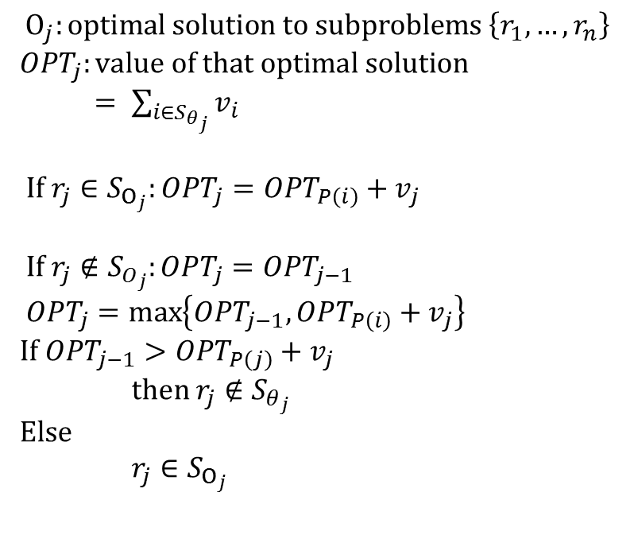
Subproblems look like solve the same problem on $\left\{r_{1},…,r_{j}\right\}$
$1≤j≤n$
$$Ο_{j}:\text{optimal} \text{solution} \text{to} \text{subproblems} \left\{r_{1},…,r_{n}\right\}$$
$OPT_{j}:\text{value} \text{of} \text{that} \text{optimal} \text{solution}$
$= \sum_{i∈S_{θ_{j}}}{v_{i}}$
$If r_{j}∈S_{Ο_{j}}:OPT_{j}=OPT_{P\left(i\right)}+v_{j}$
$\text{If} r_{j}∉S_{O_{j}}:OPT_{j}=OPT_{j−1}$
$OPT_{j}=\max\left\{OPT_{j−1}, OPT_{P\left(i\right)}+v_{j}\right\}$
$\text{If} OPT_{j−1}>OPT_{P\left(j\right)}+v_{j}$
$\text{then} r_{j}∉S_{θ_{j}}$
$\text{Else}$
$r_{j}∈S_{Ο_{j}}$

Slide 24
Compute_WIS(i, P)
if j == 0:
return 0
Else
s1 = Compute_WIS((P(i), P) + v_j
s2 = Compute_WIS(j-1, P)
return max(S_1, S_2)

Slide 25
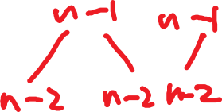









Complexity: $Ο\left(2^{n}\right)$

Slide 26
Solution: Save the results of any computation of use that as a cache
compute_WIS(j, P, M)
if M[j] is defined
return M[j]
else:
if j == 0 then
q = 0
else
q = max(S_1, S_2)
(S_1, S_2 as before)
M[j] = q
return q

Slide 27


Complexity: $Ο\left(n\right)$
each pass writes one entry of $M$ and there are only $n$ entries to write
OPT_{n}= compute_WIS(n, p, M)

Slide 28
Compute_WIS_Schedule(j, P, M)
if M[j] == M[P[j]] + v_j
print v_j
q = P[i]
else
q = j – 1
return Compute_WIS_Schedule(q, P, M)

Slide 29
Key concepts
Optimal substructure
Recursion relation between the subproblem and the main problem
Implementing recursion directly will most likely have an exponential growth

Slide 30
Memorization
Save the results. Complexity drops downs from exponential to (pseudo) polynomial

Slide 31

Divide-and-conquer
O(n²) -> O(n ln n)
Greedy: O(n²) -> $Ο\left(\log_{2}{7}\right)$

Slide 32
Fib(n):
if n == 1 or n == 2
return 1
return Fib(n-1) + Fib(n-2)
Fib(10)
10
/ \
9 8
/ \ / \
8 7 7 6
/ \ / \
7 6 6 5

Slide 33
Fib(n, M):
if n == 1 or n == 2
return 1
if M[n] is defined
return M[n]
M[n] = Fib(n-1, M) + Fib(n-2, M)
return M[n]
O(n)

